Slide 1

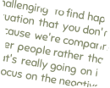




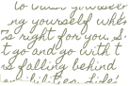
DAILY AI NEWSLETTER
By Aditi Mandal

Slide 2
EXECUTIVE SUMMARY
Objective: Automate daily AI/ML newsletter production.
Key Features:
Content aggregation via NewsAPI.
AI-powered summarization using OpenAI’s GPT-4.1-mini.
Email distribution through Gmail.
Outcome: Consistent, timely delivery of curated news with minimal manual intervention.

Slide 3

WORKFLOW OVERVIEW
Linear Process Flow:
Scheduled Trigger (Daily at 18:00).
Content Aggregation (Fetch top AI/ML articles).
Filtering (Select top 5 articles).
Summarization (GPT-4.1-mini generates concise summaries).
Compilation (Structured newsletter format).
Distribution (Email to predefined recipient).

Slide 4
KEY COMPONENTS & TECHNICAL CONFIGURATION
Nodes and Functions:
Schedule Trigger: Initiates workflow.
HTTP Request (NewsAPI): Fetches articles with keywords "AI," "ML."
Code Node: Filters articles (removes incomplete/irrelevant entries).
OpenAI Agent: Summarizes articles (2–3 sentences each).
Gmail Node: Sends newsletter with dynamic subject/body.

Slide 5
DATA FLOW ARCHITECTURE
Sequential Steps:
Trigger → NewsAPI → Filtering → Summarization → Formatting → Gmail.
Data passed as JSON between nodes.

Slide 6
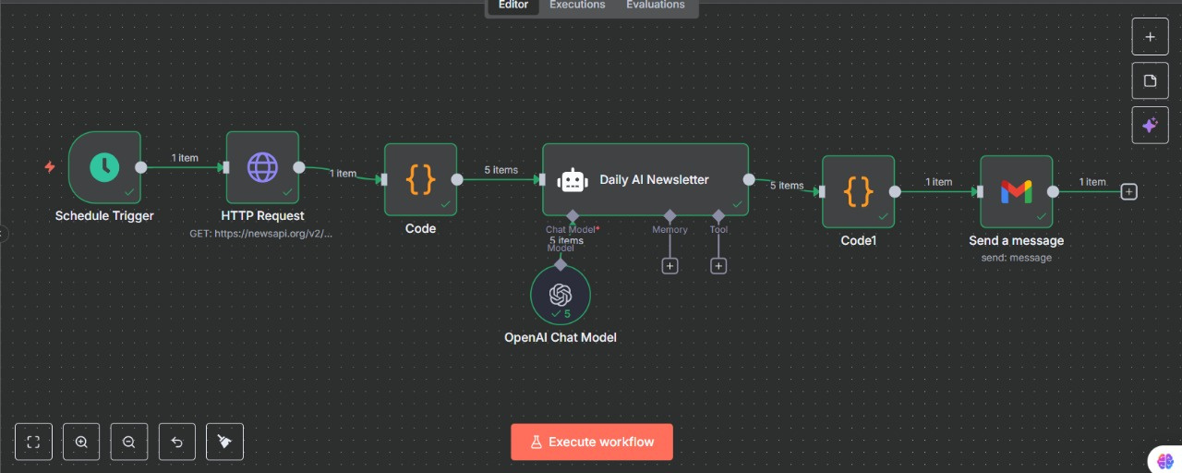
WORKFLOW

Slide 7
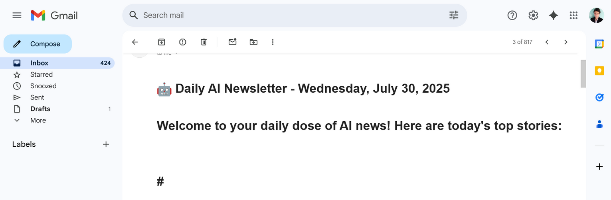
RESULT

Slide 8
CONCLUSION
Impact: High-value informational product with low overhead.
Future Potential: Template for automating other domain-specific newsletters.
Call to Action: Explore enhancements for scalability and security.

Slide 9
THANK YOU

